Slide 1
Hardware

Slide 2
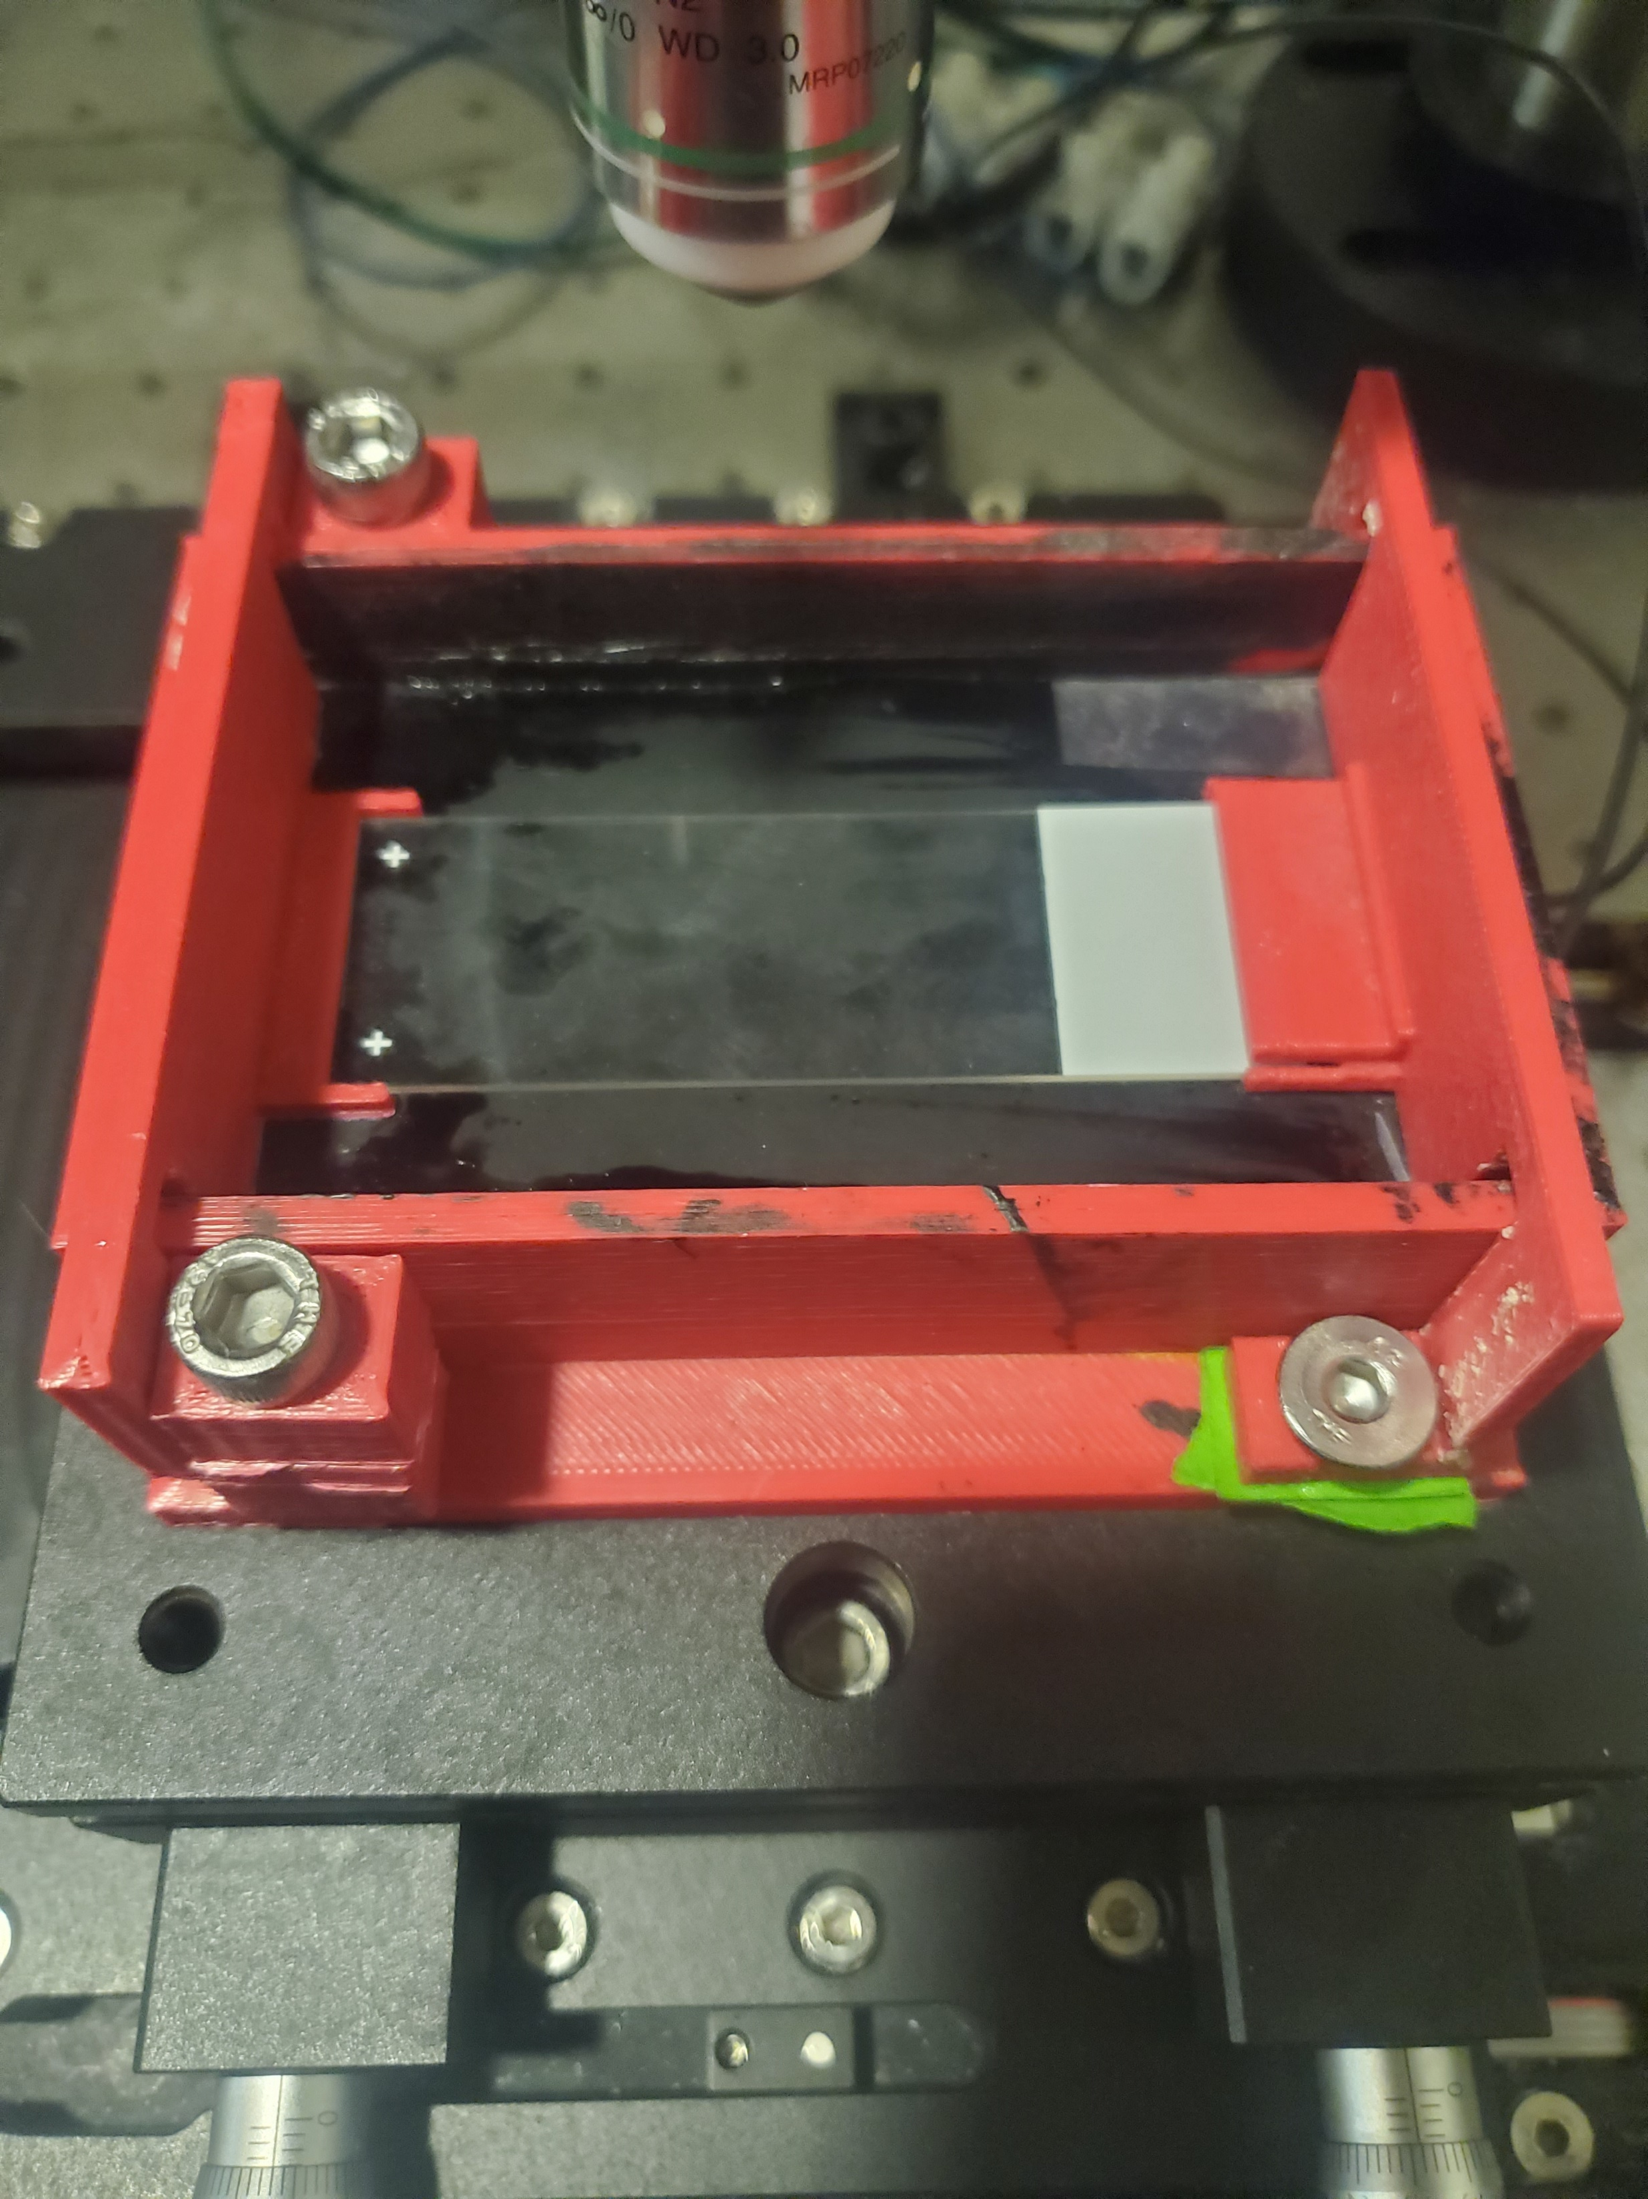
Slide and Pressure Plate guides

Slide 3
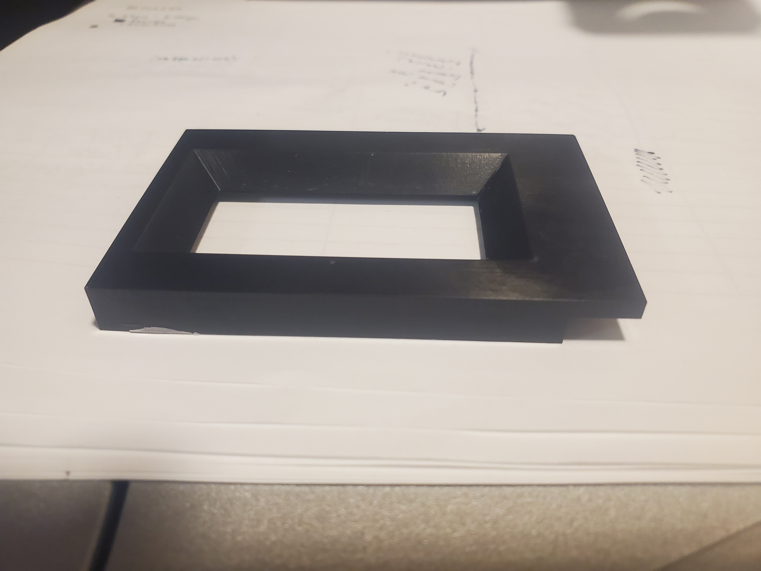
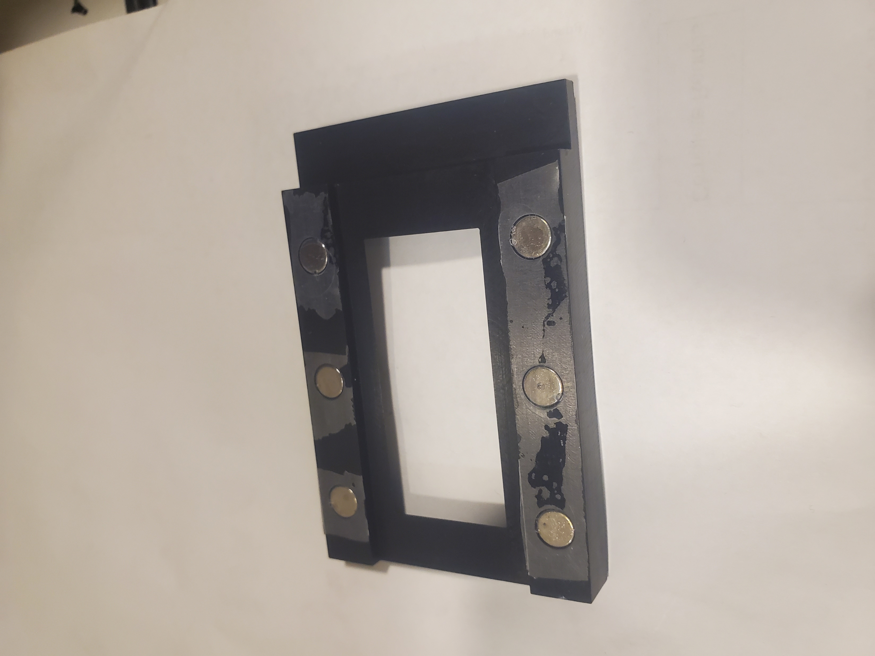
Pressure Plate (Aluminum)

Slide 4
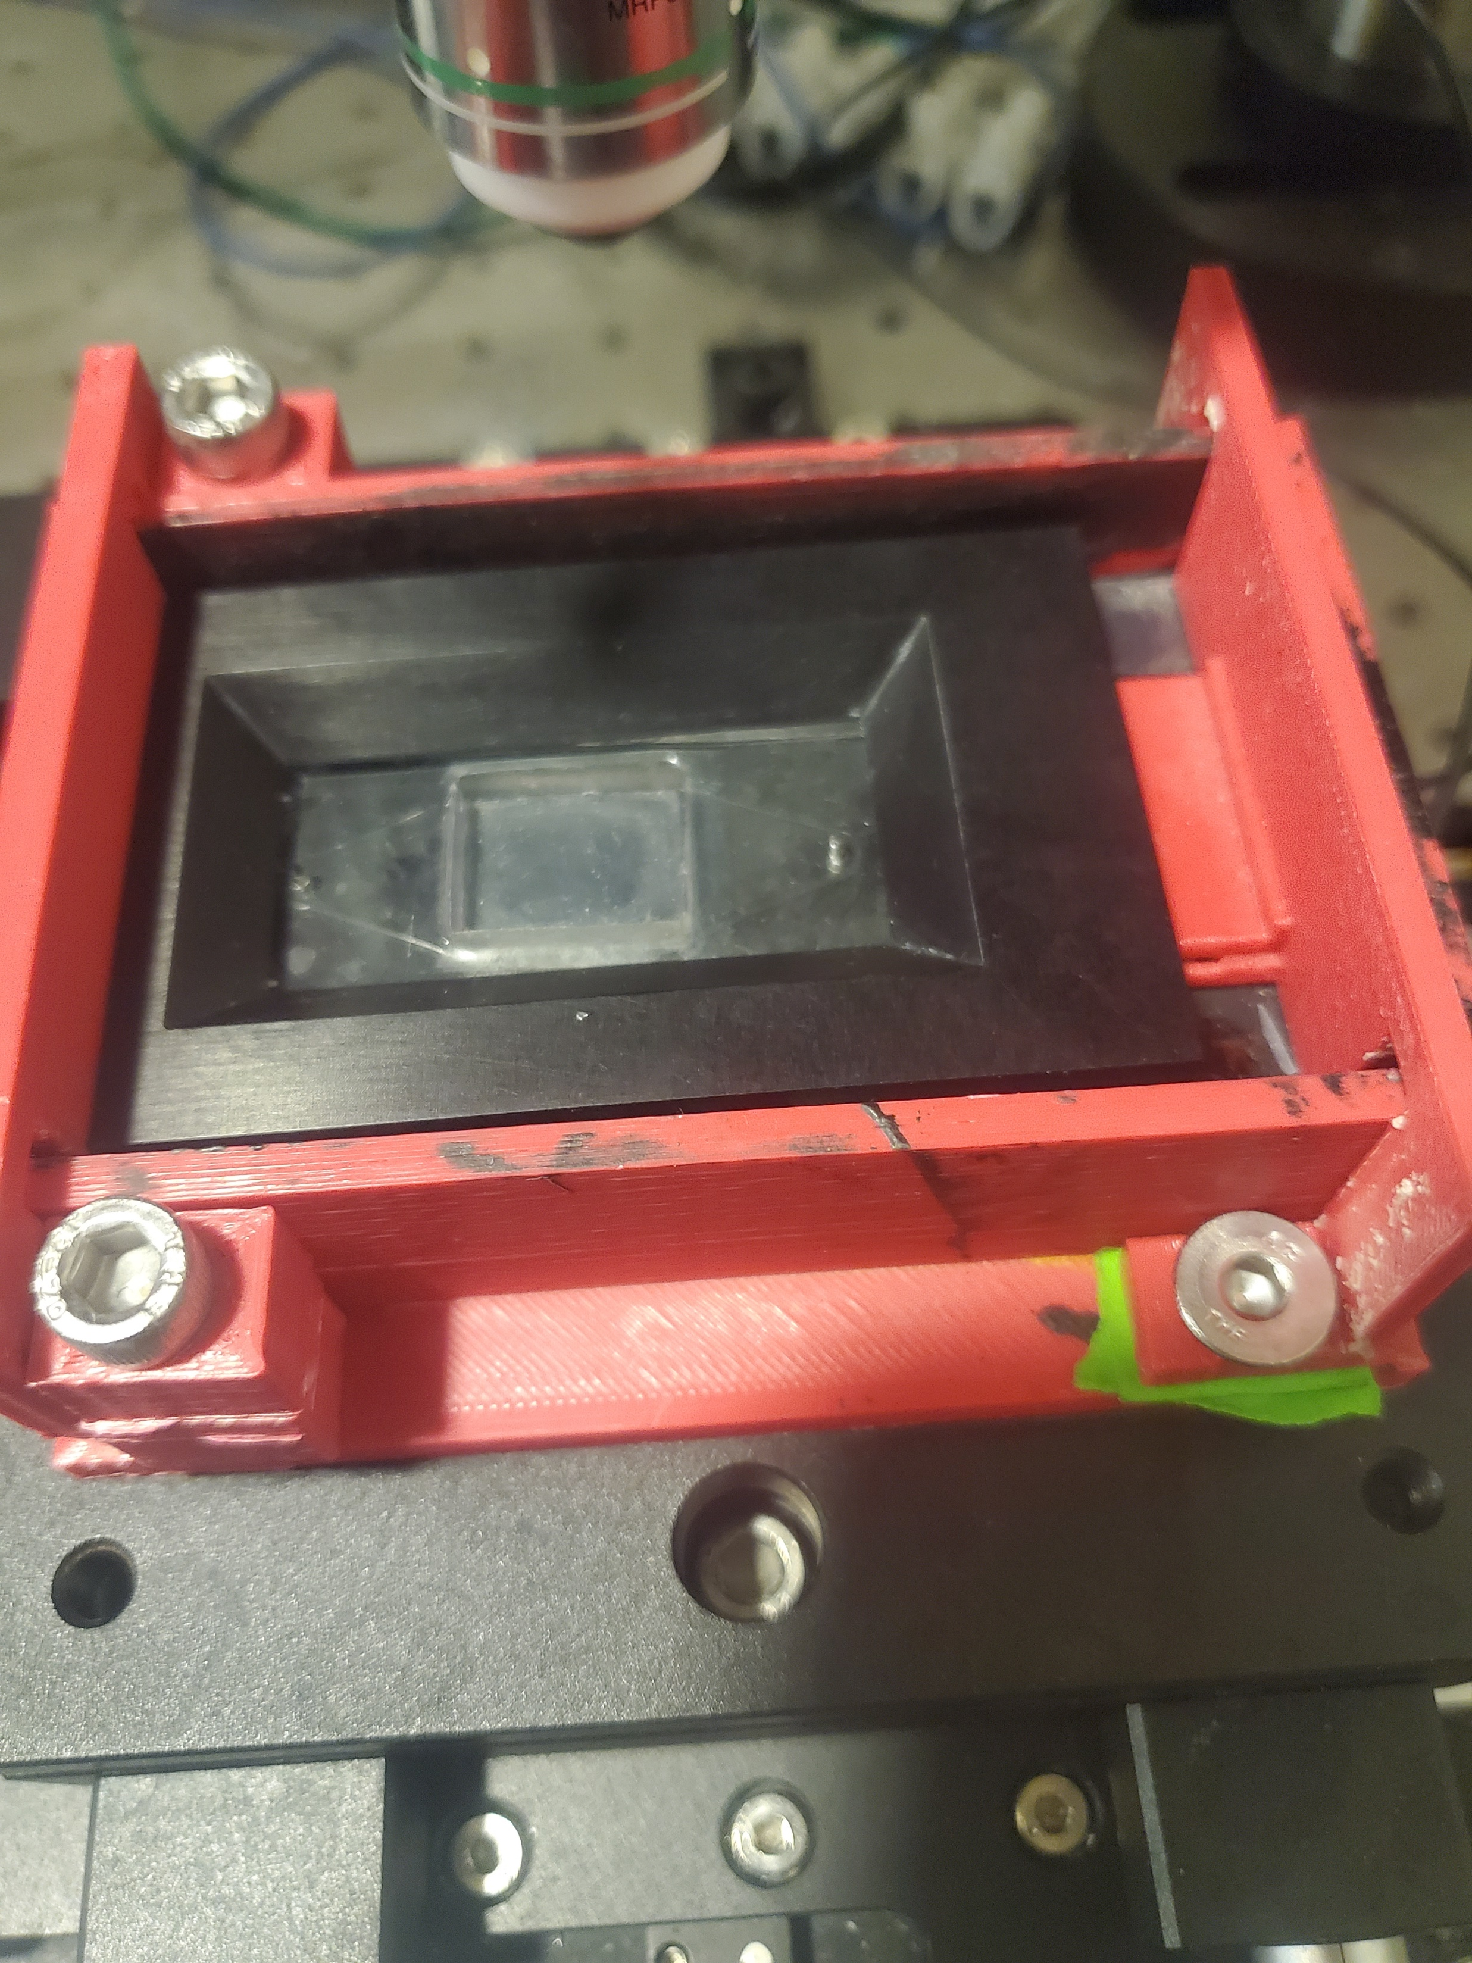
Combo

Slide 5
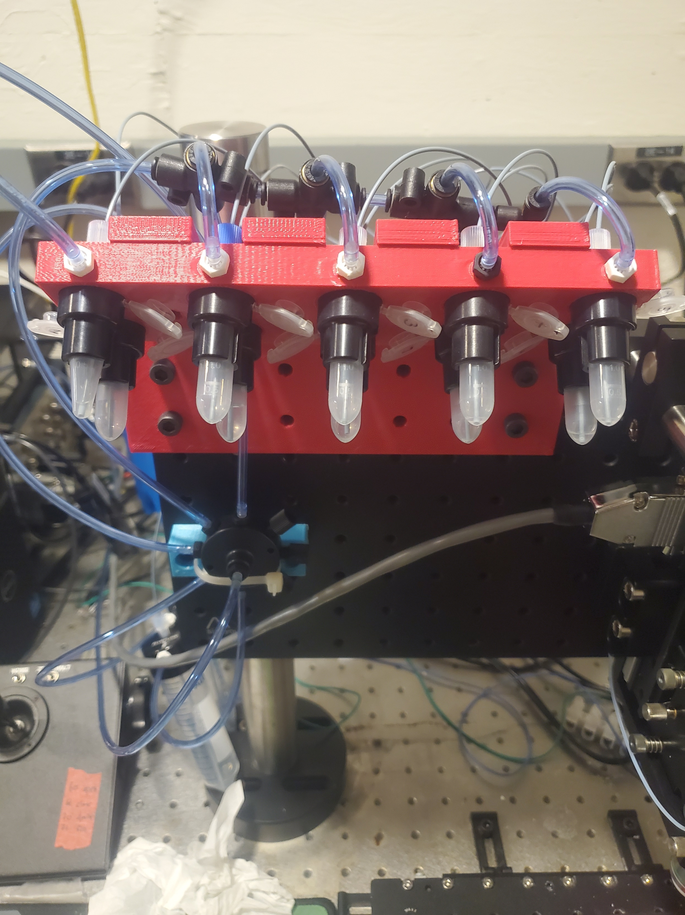
Vial/Fluidic System interface

Slide 6
Previous Cycle, Star-Dist Autofocus and Auto-Exposure Block Diagram

Slide 7
Chromatic Aberrations and Planer Correction
Chromatic aberration is due to dispersion. Usually objectives corrected across colors (apochromat is best)
By default a classic single lens has a single focus point that changes as you move off axis. Combo of lens attempt to keep focus point in same flat plane, agnostic of displacement off axis. (plane objectives)
Wide field imaging is generous with focal planes.
Pushing FOV limits was too much for the objective. It can supply more FOV, but gives significant warping of the focus plane on the edge. Virtually crop images now to compensate.
Built in known offsets compensate for chromatic abberations.
Ideal Conceptual Focal Plane of Objective. All Colors same focal plane
AutoCyPlex Objective
8um diff DAPI to A488 focus
6um warp
1.5um A488 to A647

Slide 8
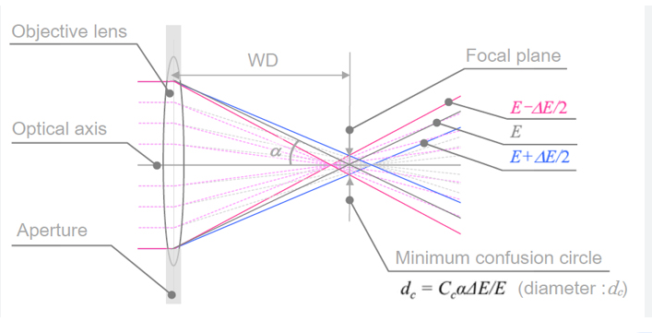

Slide 9
Idea and Assumptions
To acquire data, we currently acquire zstacks about the approx. focus plane in order to make certain that the in focus image is captured.
An issue with this method is the focal plane shifts slowly over time leading to needing larger stacks or to adjust the center position of the z stack to be closer to the focal plane.
In the past strategies like triple image brenner score work well, but fail too often to be relied upon. A much larger scanning stack can be used, but it is very time consuming.
The presented method is based up using the prior cycle’s dapi images and recentering the stack on the most in focus image.
To find the true nuclei and not just junk plus nuc plus other stuff like autofluorescence, we employ the pretrained stardist network to identify nuclei.
Bonus info may be to use segmented binary version of stardist output to identify where tissue is and indicated those so only those area need to be acquired.
Assumptions
Crux of this method working is that I have drift of < 2-4um in a single cycle.
Cycle 0 in focus images are in initial stack. Aka, micromagellan surface is set in focus from the start.

Slide 10
Workflow
Cycle 0 image Acquire
Segment via StarDist to generate mask
Calculate brenner score on masked nuclei images from z-stack n and find highest value
Shift position in focus map to center the highest brenner score slice
Acquire cycle n z-stack (if n=0, use cycle 0 image stack instead)
Apply shifted focus map to acquire new z-stack for cycle n+1
Initial mask generation

Slide 11
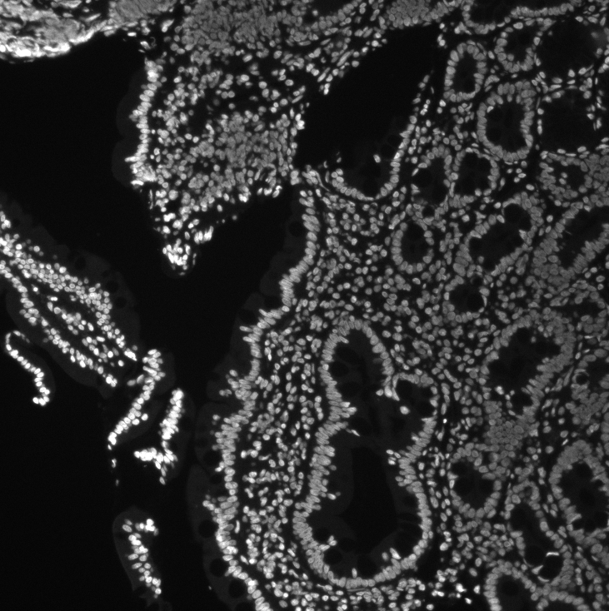
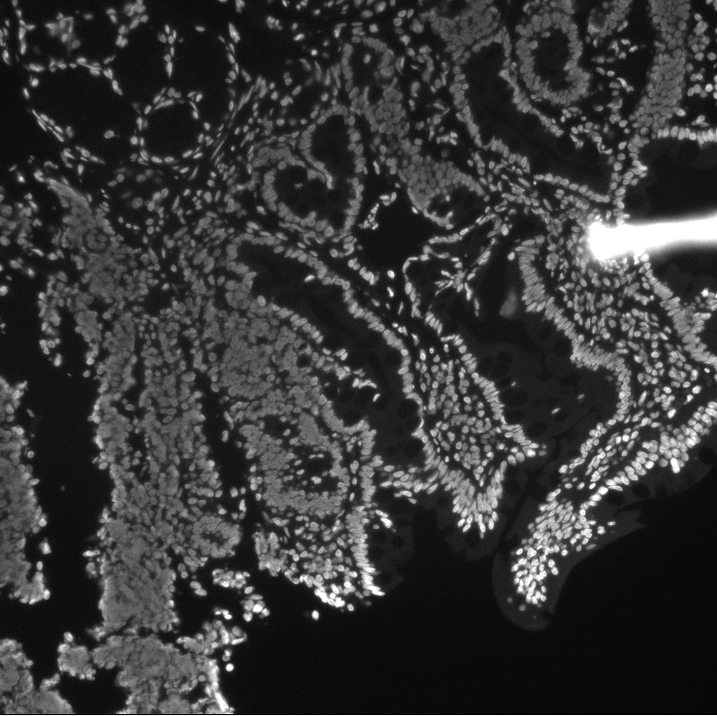
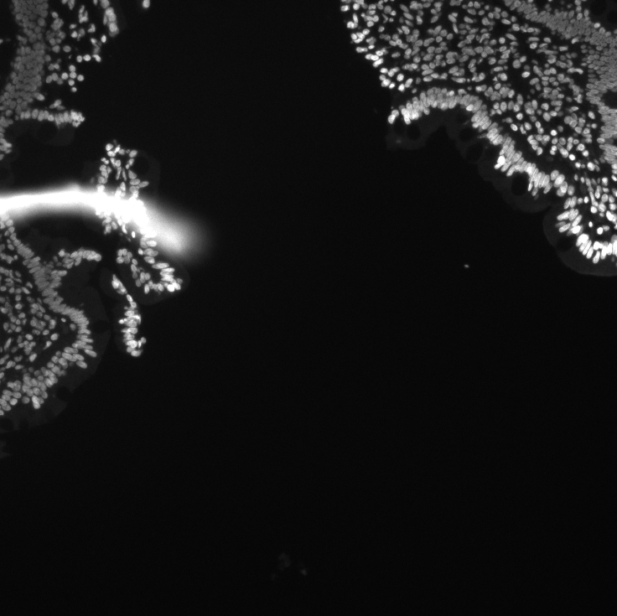
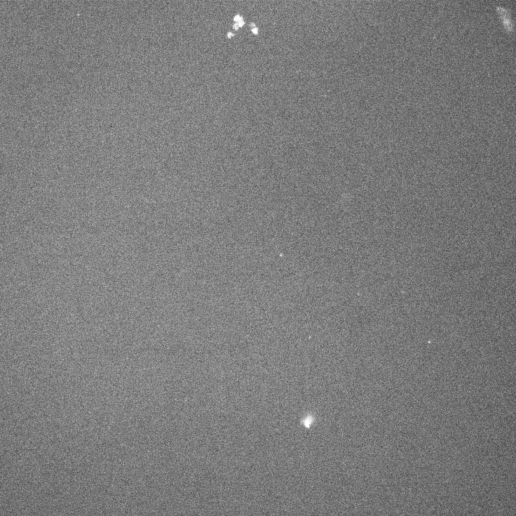
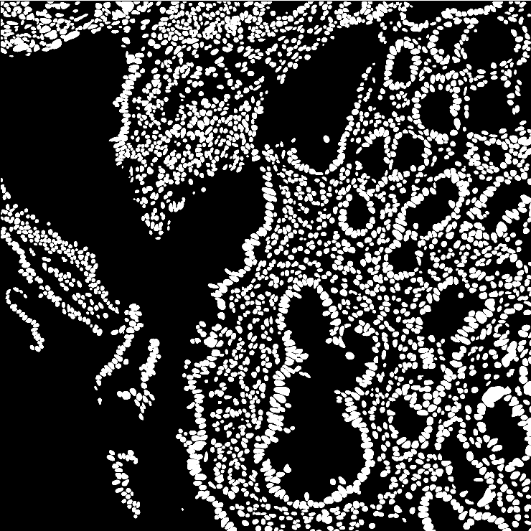
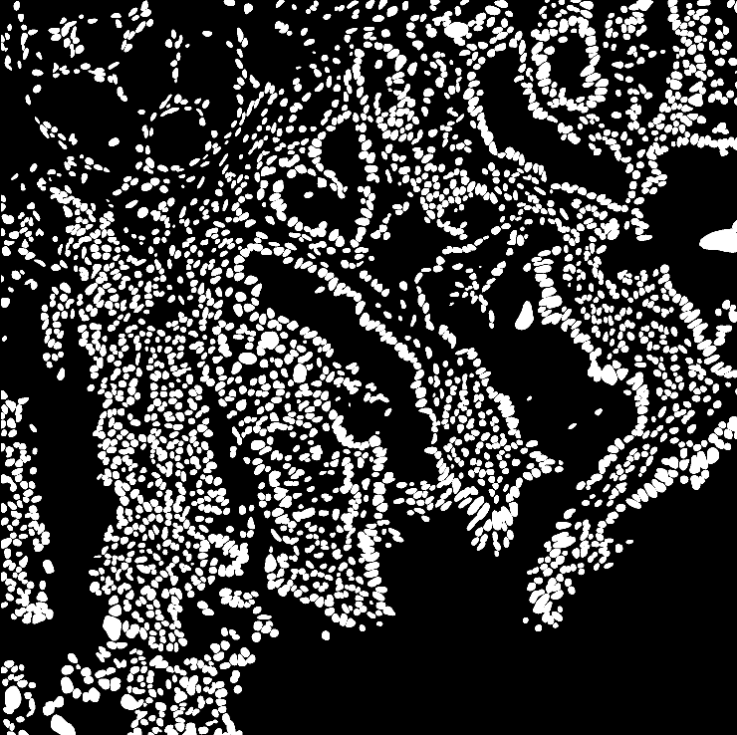
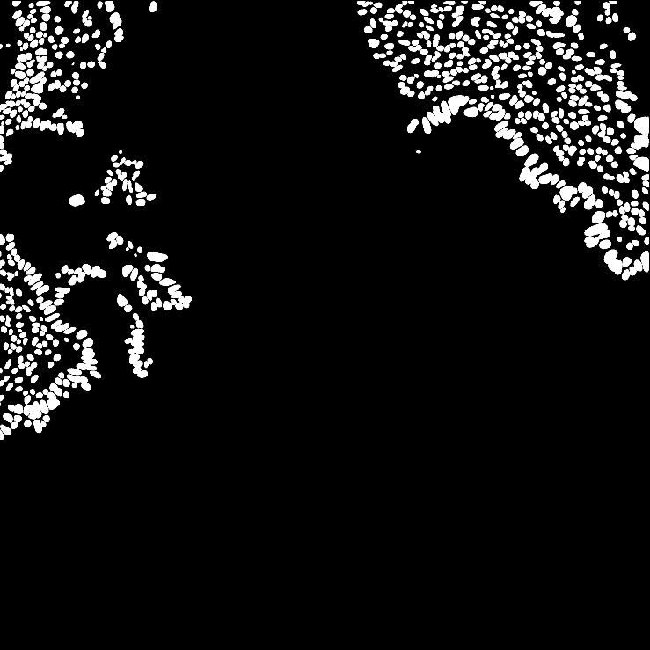
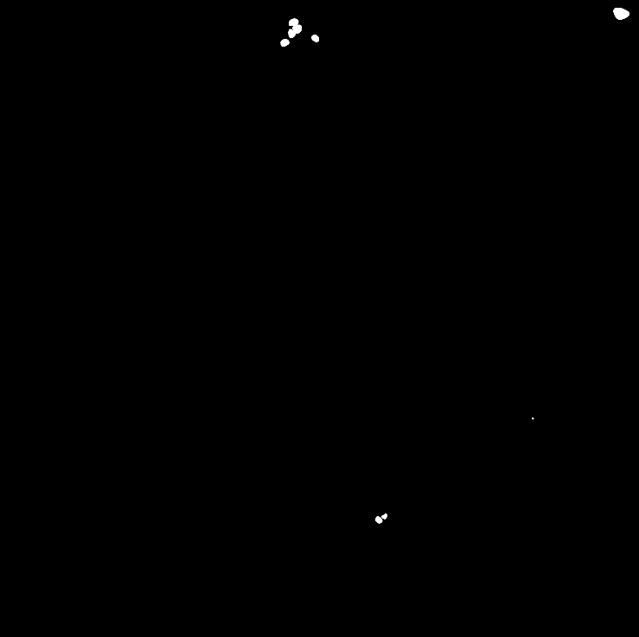
Images to Mask
Images
Masks

Slide 12
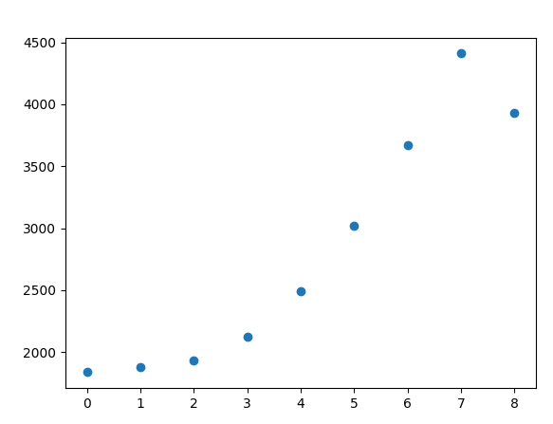
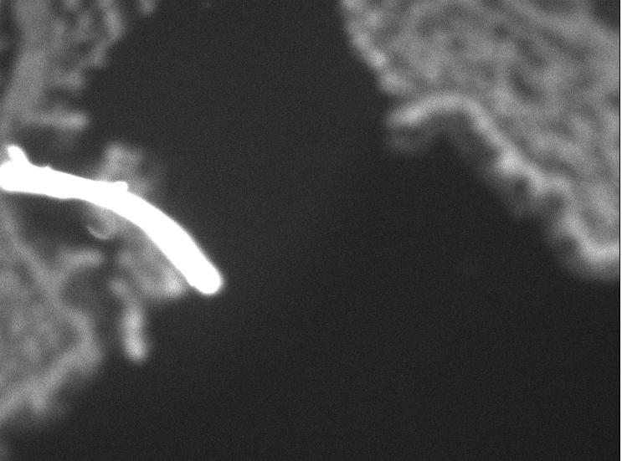
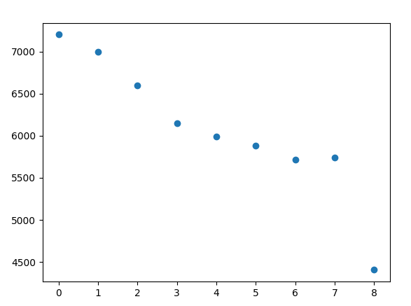
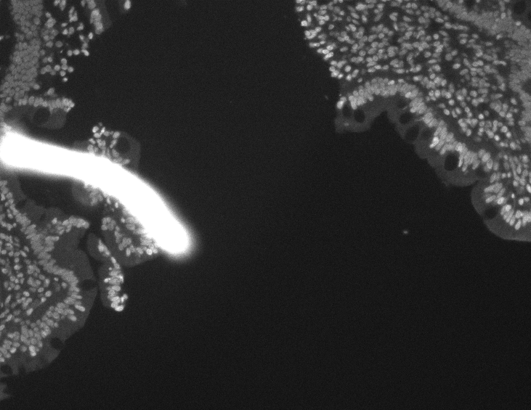
With/Without Stardist
Without Star dist
Slice 7
With Star dist
Slice 0

Slide 13
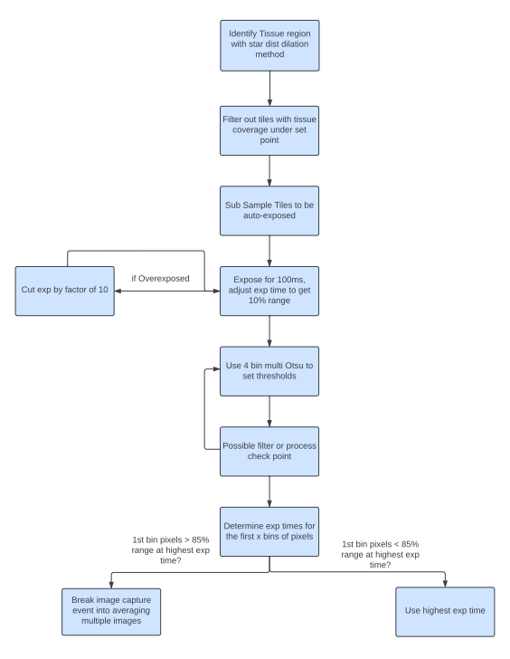
Auto-Exposure Algorithm
Block Diagram

Slide 14
Kinetics Equation and 16-1-24 data set

Slide 15
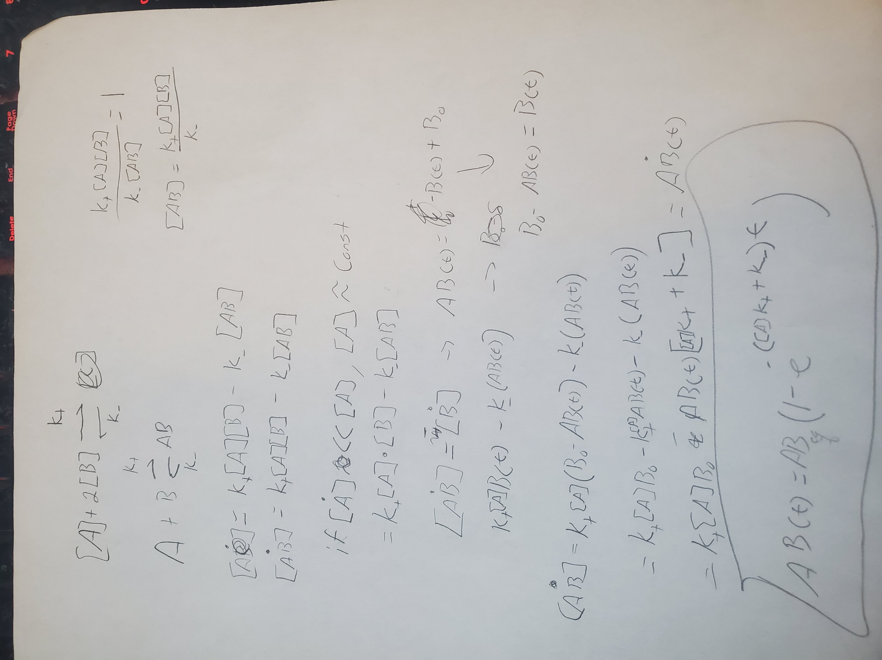
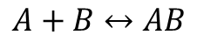
Kinetics time-based derivation
$$A+B↔AB$$
$$AB\left(t\right)= {AB}_{eq}\left(1−e^{−\left(\left[A\right]k_{+}+k_{−}\right)t}\right); {AB}_{eq}=(\frac{k_{+}}{k_{−}}\left[B\right])∗[A]$$
Binding speed roughly proportional to antibody [C]
Ultimate concentration proportional to antibody [C]
Can’t single shot to solve full equation. Reduce to:
$$AB\left(t\right)= {AB}_{eq}\left(1−e^{−kt}\right); k=\left[A\right]k_{+}+k_{−}$$

Slide 16
Parameters to Modulate
Ionic strength of solution (antibodies are predicted to go towards antibodies via electric force and van-der-waals once socketed. Ions in fluid provide a screening effect to electric fields within liquid)
Temperature (20C and 44C)
pH (I am comparing pH5 and 7 here, but larger range is appropriate)
Antibody Concentration
Parameters to Quantify
K value of binding kinetics (report as half life)
Plateau Signal Value (ABeq)
Signal/background ratio
Approximate S/N

Slide 17
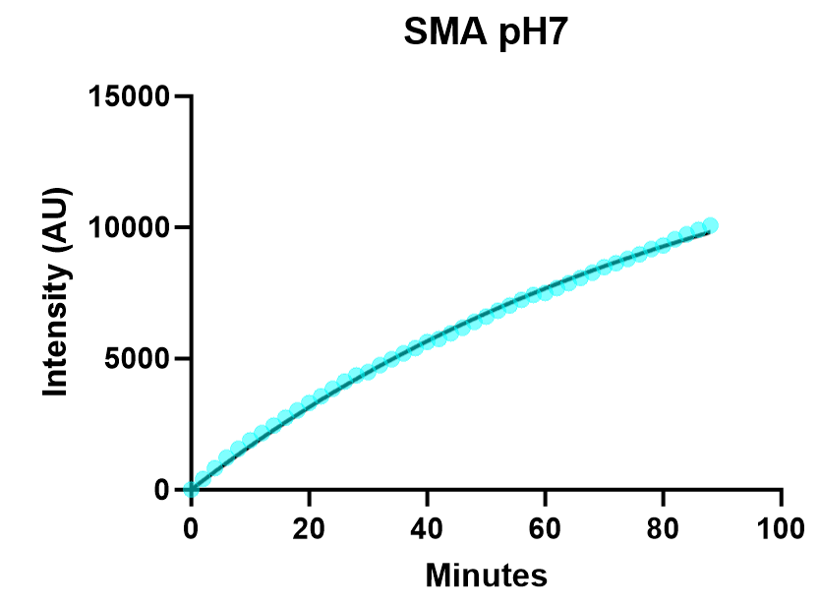
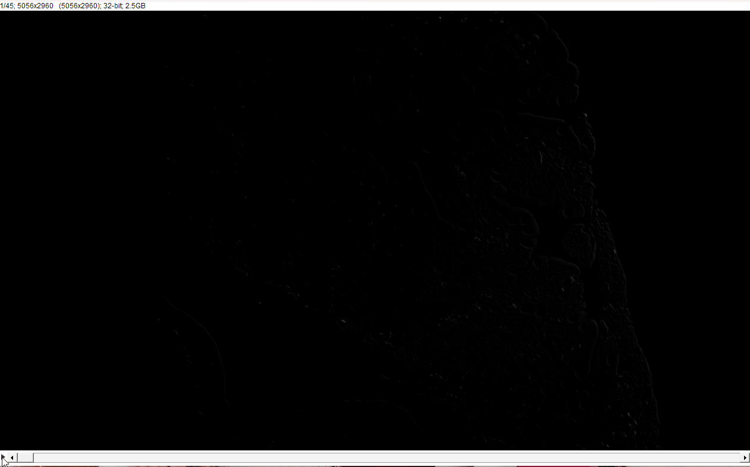
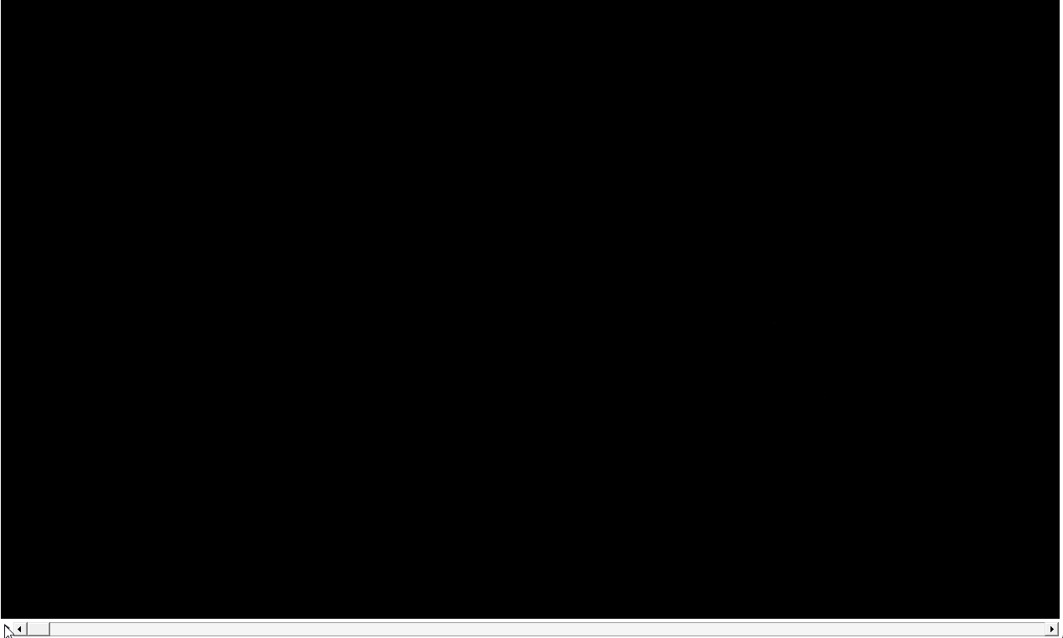
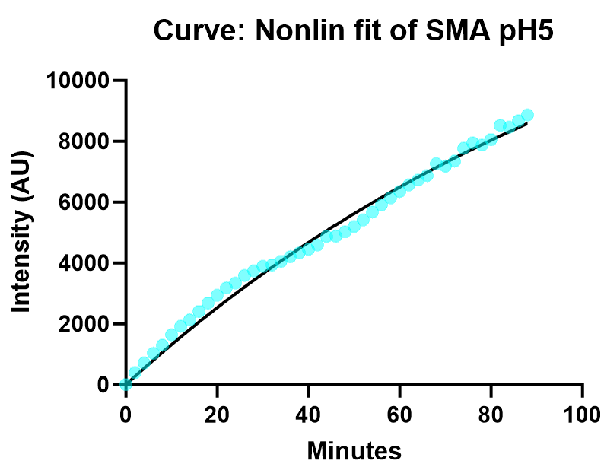
Kinetics of Signal
pH 7
Half Time = 62 +- 3 minutes
Plateau = 15.6E3 +- 0.5E3
pH 5
Half Time = 84 +- 10 minutes
Plateau = 16.6E3 +- 1.5E3

Slide 18
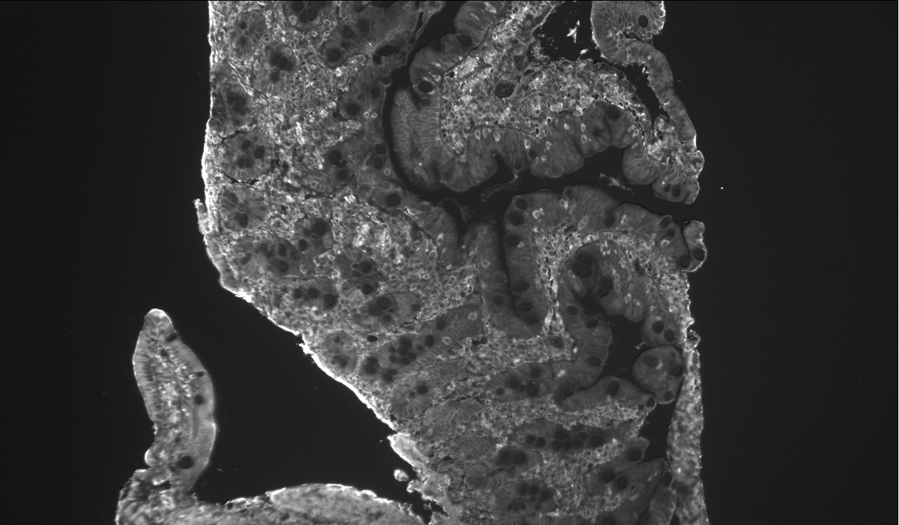
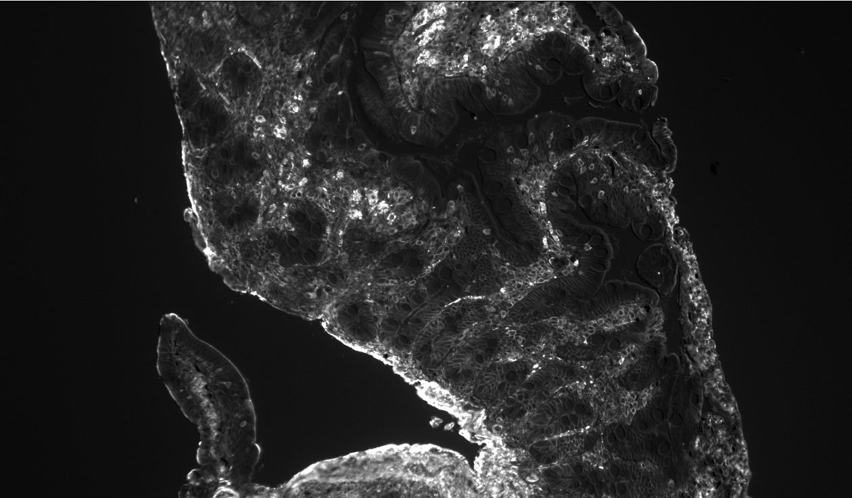
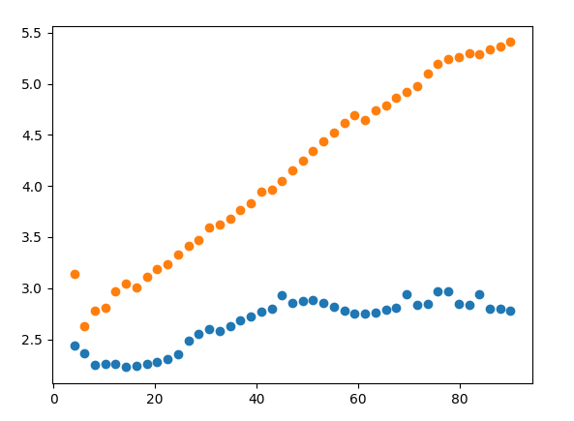
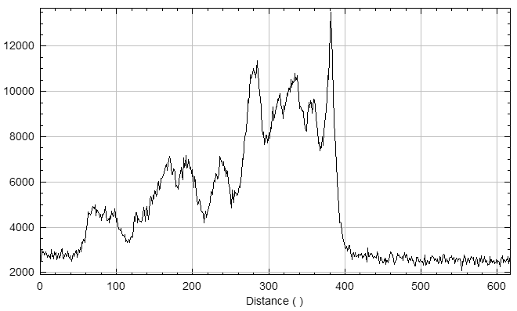
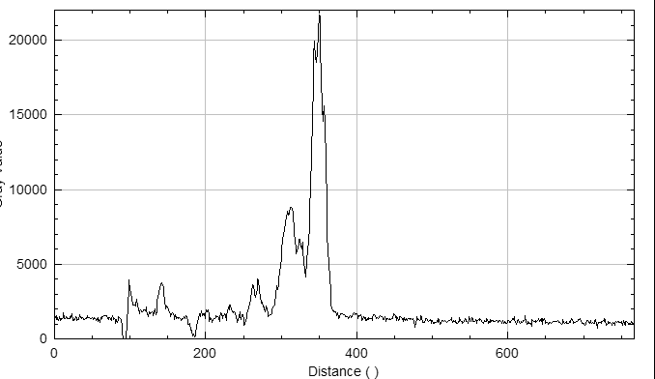
Signal/Background
Compare signal from applying signal mask to inverse signal mask (bounded by tissue boundaries)
pH 5
Same display range!
pH 7
pH 7
Signal/Bckgrnd
pH 5

Slide 19
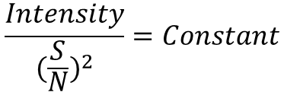
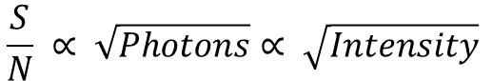
Sanity Check (S/N Ratio)
Imaging squarely in Poisson noise regime
True S/N is a non-trivial calculation with no ‘True’ solution in imaging except in trivial systems
Rough proxy for S/N = Mean/Std
$$\frac{S}{N} ∝ \sqrt{Photons}∝ \sqrt{Intensity}$$
$$\frac{Intensity}{{(\frac{S}{N})}^{2}}=Constant$$

Slide 20
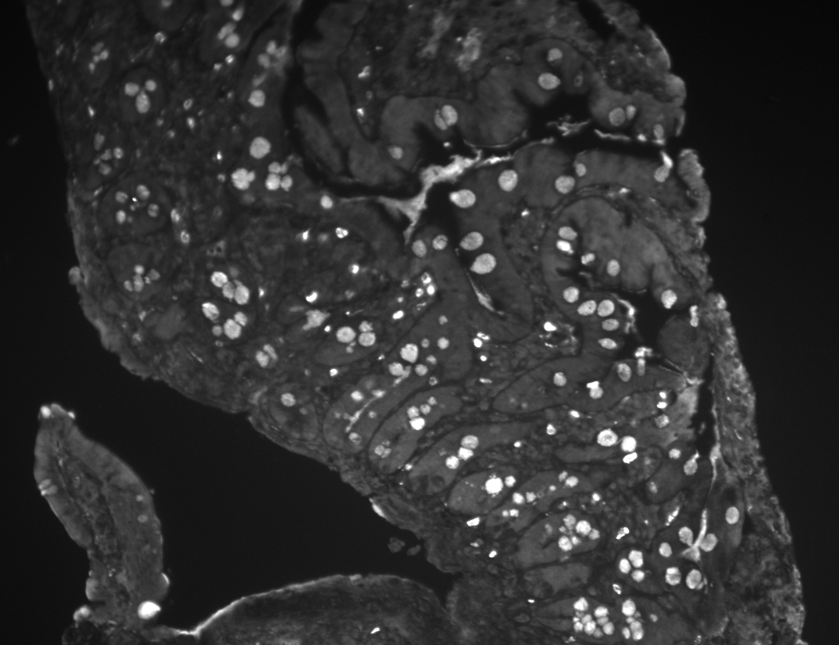
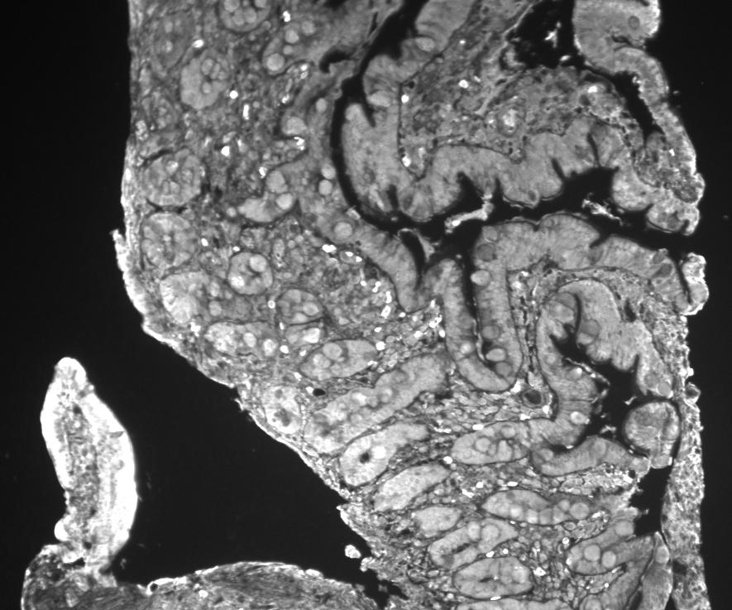
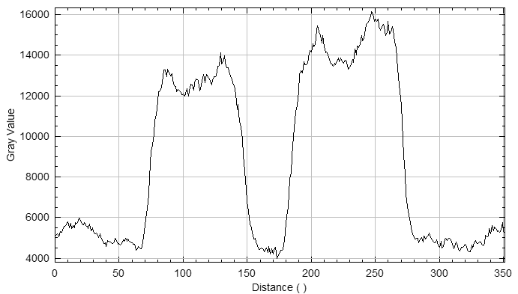
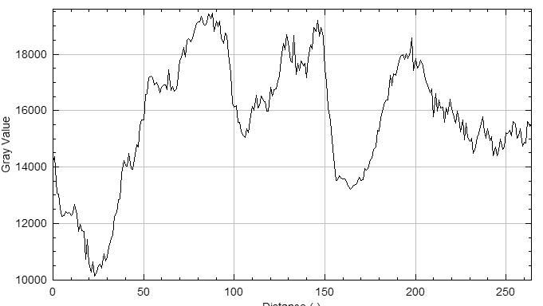
MUC2 End Point Images
pH 7
Same display range!
pH 5
Gob
Gob
Tiss
Tiss
Gob
Tiss
Tiss
Tiss

Slide 21
Results
Stain | SMA pH 7 | SMA pH 5 | MUC2 pH 7 | MUC2 pH 5
Half Time (min) | 62 +- 3 | 84 +- 10 | 63 +- 4 | N/A, fit failed
Plateau (AU) | 15.6E3 +- 0.5E3 | 16.6E3 +- 1.5E3 | 17E3 +- 0.8E3 | N/A, fit failed
S/Bckgnd - 1 | 4.4 | 1.78 | 3.08 | 0.34
S/N | 2.4 | 2.69 | 2.79 | N/A

Slide 22
Recommended Processing Workflow
Bleached image subtraction
Flatten illumination via BaSiC (current implementation is sloppy, need to actually establish reference images)
Decon (Richardson-Lucy)
N2V (optional)
Ashlar (imaging stitching and cycle registration)
unMISCH (nuclei), option in StarDist
Use a nuclear based approx. method and or CellPose to segment cytoplasm
iLastic or Otsu models for all other channels
Cluster and visualize via scimap and Minerva (I haven’t investigated this area yet)
Green = processing
Orange = segmentation
Blue = cluster and visualize

Slide 23
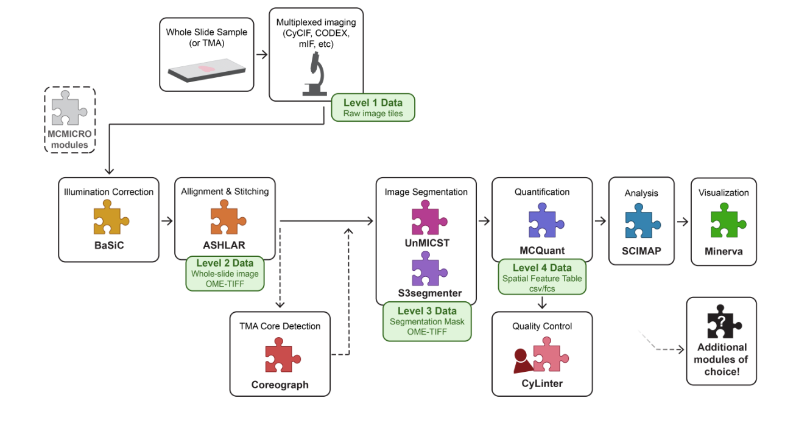

Slide 24
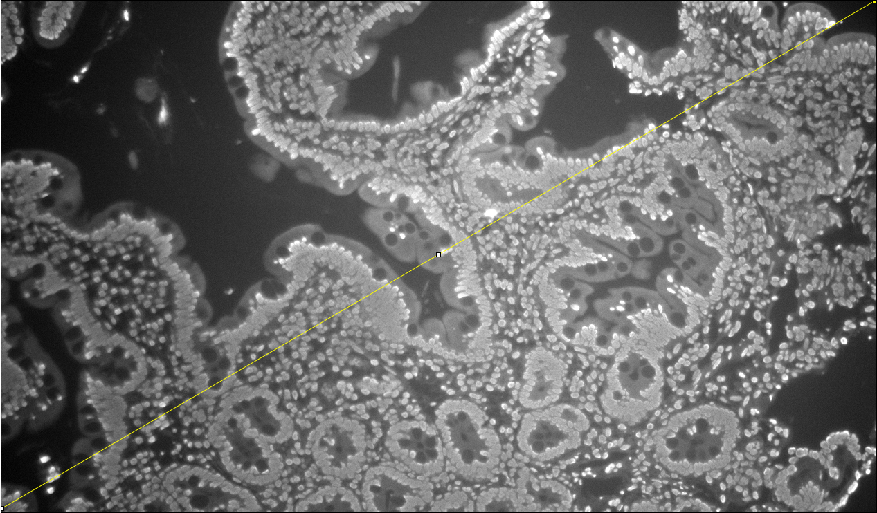
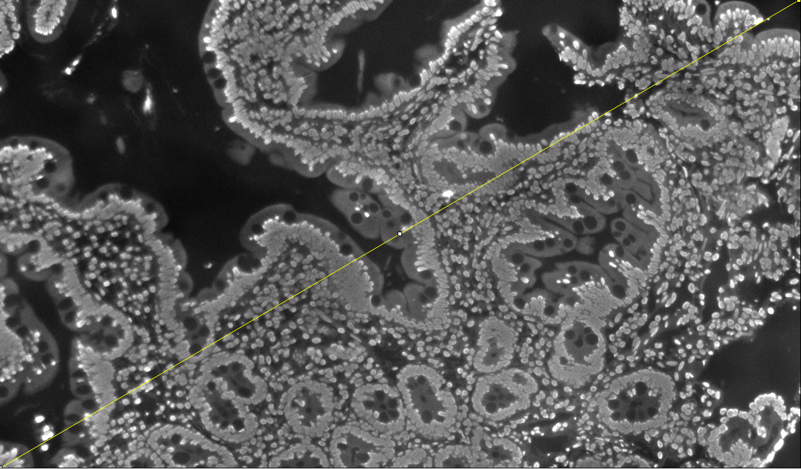
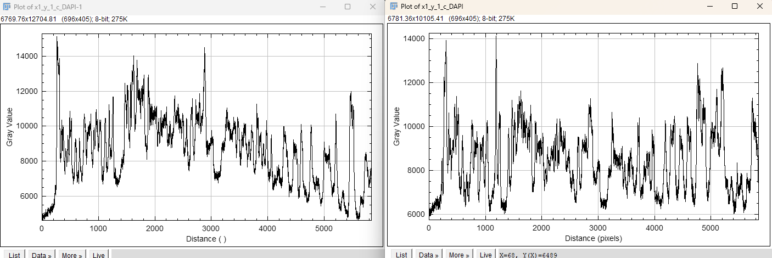
BaSiC Demo
Raw
Basic Estimator Applied

Slide 25
Noise2Void demo

Slide 26
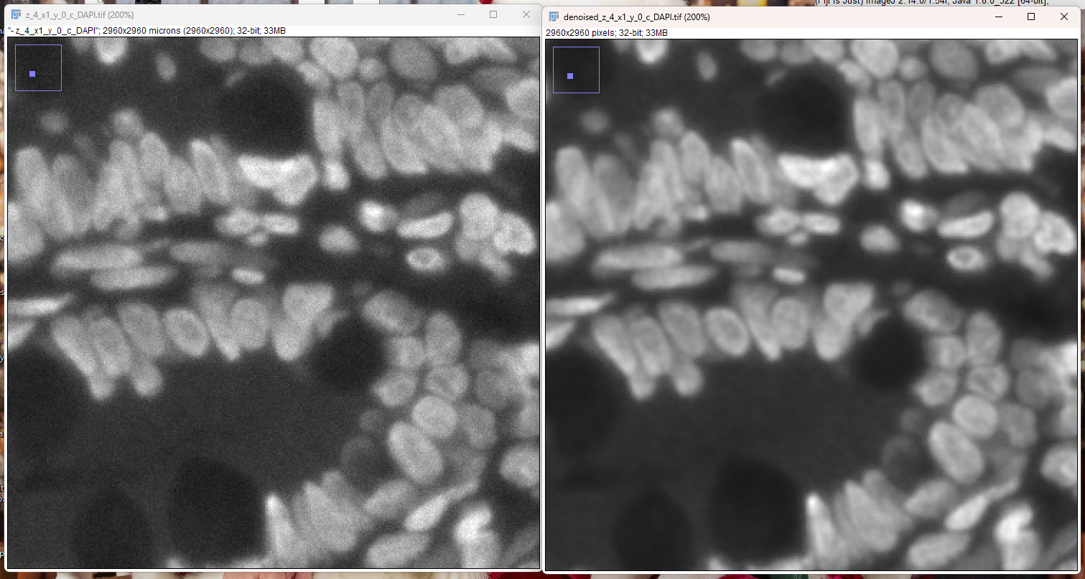
DAPI

Slide 27
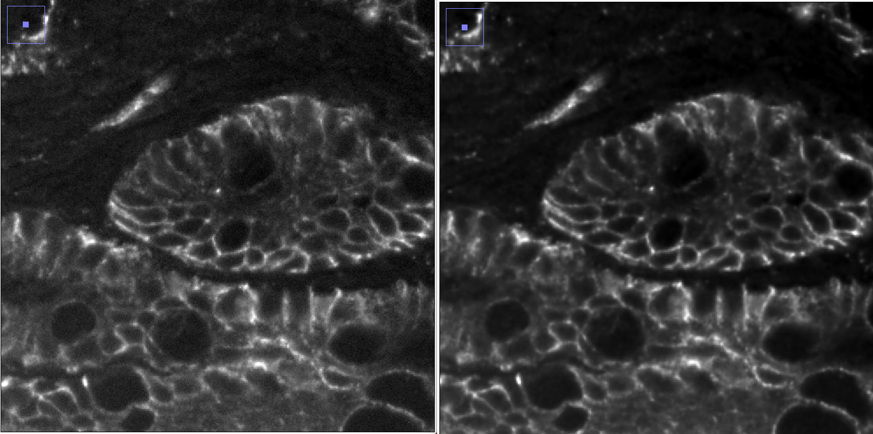
EPCAM
Raw
N2V

Slide 28
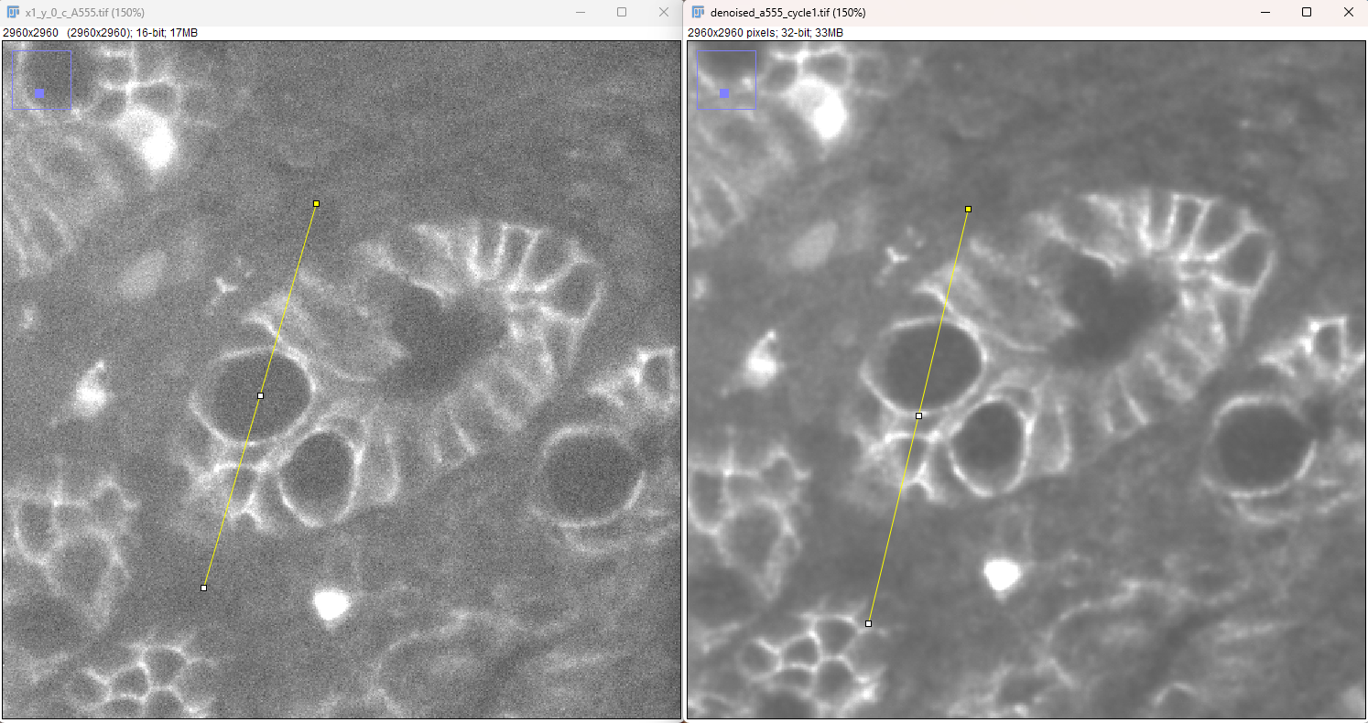
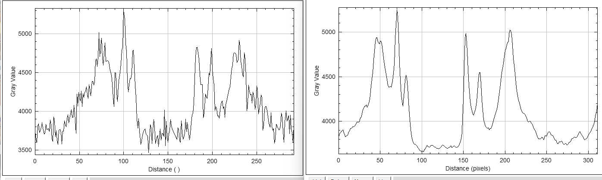
A555_cycle1

Slide 29
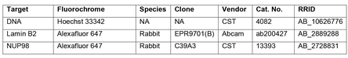
Nuclei Segmentation
Originally thought was “solved” problem
Only “solved” for 2D monolayer cultures
Tissue still unsolved and moderately challenging
unMICST formulated by Sorger lab is current best solution to problem
unMICST utilizes backbone of one of 3 well established networks (uNet, Mask-R-CNN and PSPNet )
Trained on saturated, unfocused and focused data. This augmentation significantly increased accuracy
Also to increase accuracy, stain lamins as well as intercalated dyes ie DAPI. This drastically increased accuracy in high density areas (unMICST has duo model to use with lamin and DAPI dual channel stains)
Unique aspect of unMICST is ability to output nuclei bodies, centroid and borders
Lamins vary nucleus to nucleus via cell types. Following combo is currently known best universal stain:

Slide 30
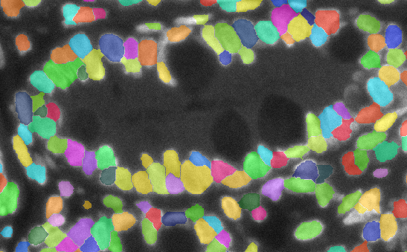
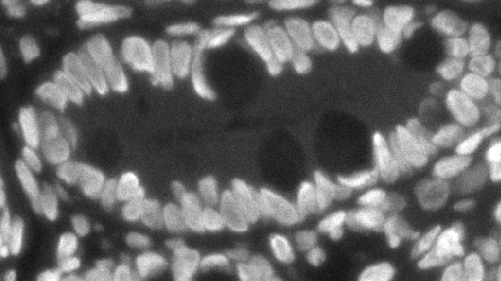
DAPI via unMICST

Slide 31
Cytoplasm Segmentation
More challenging than nucleus
Multiple ways to segment/approximate
Approximation
Pad nucleus segmentation with x pixels (typically 3-5, but depends on um/pixel). Additional layer on this method is to prevent overlapping by using eqi-distance limitations as cytoplasm borders hit each other
This is considered a legit and acceptable approximation. Not just me spitballing
Segmentation Methods
Use Nucleus as a seed and additional channel such as Ecad alongside watershedding
Note given a channel like Ecad typically doesn’t cover the entire cell spectrum, it can be used in hybrid mode with the above approximation to more accurate get epithelial cells and approximate the rest
A power of this is that watershed’s weakness is it inherently doesn’t know seed points. Accurate nuclei segmentation is able to cover up the weakness by supplying it with accurate seed locations
Use stains/combo of stains to segment. Sorger lab has pre built model that uses WGA for segmentation
Note for both methods 1 and 2, stains that outline borders can be added together to target higher amounts of cells
This is essentially the same as number 2, but I wanted to delineate them as the above are available sorger developed. Other models of which CellPose appears to be the best one can use markers like Ecad to find cell boundaries too.

Slide 32
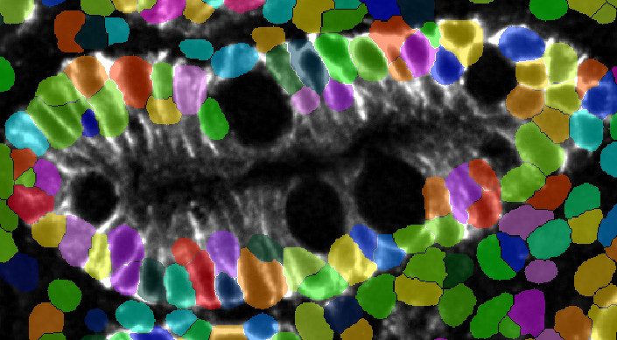
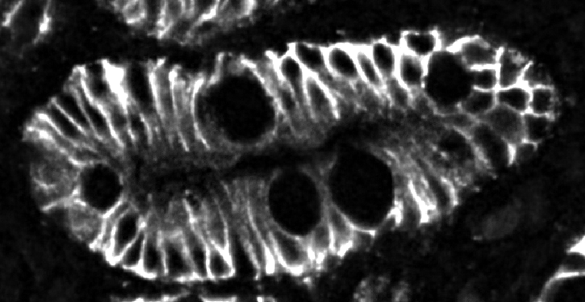
Approximation

Slide 33
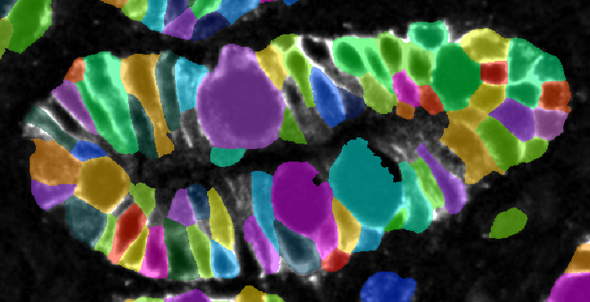

Cell pose partially trained HIL network

